Slide 1
New Trends & Uses of Technology For Local Government
Presented By:
Tom Mitchell, President & CEO, Bonefish Systems
Clint Pelfrey, AIF, Vice President, Bonefish Systems
Notes:
Good Afternoon everyone. As Rhonda said, I’m Clint Pelfrey with Bonefish Systems.
Over the past year or so I have had the opportunity to meet many of you at these monthly luncheons. I know some of you have attended the periodic Lunch & Learn sessions we hold where we discuss a variety of topics including the challenges you all face in your roles with the cities or municipal organizations you represent with regard to asset management, audit controls, compliance and in particular fraud detection and prevention efforts.
Bonefish Systems provides fiscal officers and financial managers with a broad array of easy-to-use, hosted, web-based software applications. Our programs help manage and audit vendor and payroll payment systems, mitigates risk by detecting and preventing fraud, provide automation of compliance requirements and enhancing internal efficiency, as well as identifying manual errors and duplicate payments.

Slide 2
Introduction
Tom Mitchell
Tom Mitchell is founder and President of Bonefish Systems. Mr. Mitchell has spent 26 years in the financial services sector holding numerous technology and business roles in large banks and insurance companies.
Clint Pelfrey
Clint Pelfrey is Vice President of Financial Controls at Bonefish Systems. For the past 30 years Clint has worked in the financial services industry as an Investment Officer working with many cities, municipalities, and school districts across Ohio. Clint’s also served as Chief Compliance Officer where he was responsible for establishing internal financial controls, identifying and mitigating risks and maintaining a disciplined oversight of the firm’s compliance procedures.
Notes:
Clint – Intro
I am joined today by Tom Mitchell who is the President, CEO and Founder of Bonefish Systems. You may also remember Tom from the Lunch & Learn events we’ve held.
Bonefish Systems is an information services technology company primarily focused on fraud prevention and detection capabilities which is what we are here to talk to you about today.

Slide 3
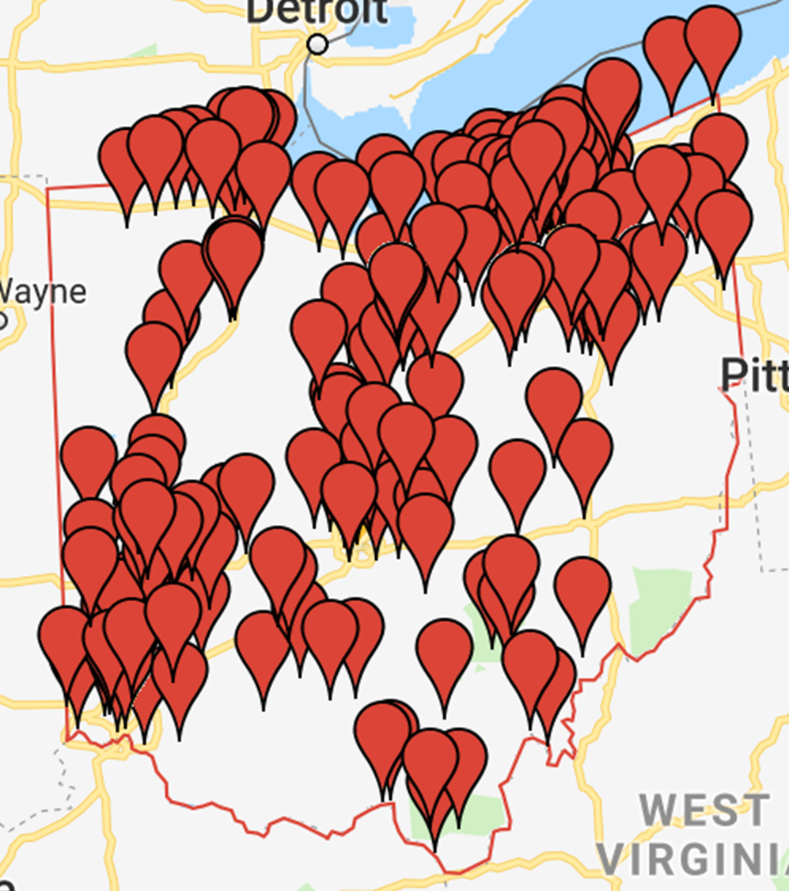
Bonefish Systems is an information technology provider of fraud detection, financial solutions and IT consulting and services.
Bonefish markets to the financial sector, both private and public, promoting easy-to-use hosted software applications and IT consulting.
Additionally, Bonefish provides managed services to local companies to support everyday business technology needs.

Slide 4
Agenda
Trends in Technology
Investments in Financial Controls
Compliance
What you can do Today

Slide 5
Technology is everywhere…

Slide 6
Technology is everywhere...
There is an App for everything
Automation surrounds our lives
We are becoming paperless
Our currency is even going ‘crypto”

Slide 7
Technology Can Also be a Threat
Data Encryption for Ransom
Crypto Currency for Ransomware Payments
Social Engineering
Phishing

Slide 8
Trends: City Investments in Technology
Smart light and LED Light Projects (smart streetlights)
Digital Kiosk Installation
Solar Powered Micro Grids
High Speed Internet
AoT( Array of things)
What About Financial Controls?
Notes:
(AOT)
Placing sensors throughout the city to collect data on the environment, infrastructure and activity, addressing traffic safety and reduce flooding costs and make the city more efficient and equitable
Installing Digital Kiosk
o To give residents and visitors real-time access to information about traffic, transit systems, and attractions like local restaurants
o This is a way to rethink how people interact with their government and policy makers and give residents easy access to details about what’s going on in their city
Smart Street Lights with Remote Controls and Sensors
o Monitoring traffic patterns and adjusting traffic lights to assist flow
o Observe parking and monitor air quality, temperature, noise and flooding

Slide 9
Are Your Financial Controls Keeping Up?
Notes:
Desribe Traditional controls, how they operate manually. Signature stamps manual searches, no automation.

Slide 10
II. Automated Controls
Positive Pay
Leverage your banking resources
Automated Continuous Monitoring
Automate monitoring of every transaction
Payment review automation and audit log
Save time on regulatory requirements
Notes:
Clint’s Slide
Let’s take a look at some Automated Controls
The Process Controls are things you can do internally with your staff or implement yourself to improve things.
With the Automated Controls, these are things you can do by relying on others outside of your organization.
For example, you can take advantage of Positive Pay. This is something we strongly encourage if you aren’t already doing it.
It makes a lot of sense.
Positive pay - offered by your bank.
Basically what it does is, when you are cutting your checks, say you are paying 100 different vendors. I cut my checks and I create a report of who I’m paying, how much I’m paying, what the check numbers are.
You send it to the bank. When the vendors cash the checks, they are matched up with the report to make sure it is all in order. If a check comes in and doesn’t match what is on the report, it gets rejected.
The intent is very narrow. It is to prevent check tampering once the check leaves your building and it arrives at the bank, want to make sure it’s the same check you wrote.
All you have to do is sign up for the service and the bank will work with you to figure out a way to transmit the report.

Slide 11
Continuous Monitoring Solutions
Fraud Prevention and Detection
Analysis on EVERY Payment
Enables segregation of duties
Transparency into vendor and employee relationships
Manual Error Identification
Example: Duplicate Invoice or Duplicate Vendor
Regulatory Compliance
Automation of required State and Federal certified external searches when initiated at time of new contract and warnings when they are required at payment
Notes:
Clint’s Slide
So what kind of things does continuous monitoring with do? There are 3 different facets:
One, and the primary focus is Fraud Prevention and Detection.
Every single payment is being checked at the time it is being cut.
We identify potential issues before the payment goes out the door. So this is not an after-the-fact review. It happens before the check is mailed.
It also enables segregation of duties through the use of the software.
And we provide transparency into relationships that exist between employees as well as vendors that you might not know about.

Slide 12
Government Technology Adoption Barriers?
Are they too expensive?
Are they too hard to implement?
Is there too much to learn?
Are fiscal officers unaware?

Slide 13
Fraud Case Review
Social Engineering: Payroll
Notes:
Fake superintendent emailed payroll staff
Created sense of urgency
Said to change routing number because he forgot it was last minute wanted to make sure he got paid
Treasurer alerted of that notification called the superintendent immediately

Slide 14
Fraud Facts
Association of Certified Fraud Examiners
2020 Global Fraud Study
Government was the 2nd highest industry victimized by fraud of the 24 industries reviewed.
$100,000 was the median financial loss in government fraud cases reviewed with 1/3 of fraud being contributed to lack of internal controls
The most common types of fraud schemes within Government are:
Corruption (48%)
Billing (18%)
Expense Reimbursements and Payroll (17%)
Resource: Association of Certified Fraud Examiners' Report to the Nation and Fraud Detection and Prevention for Accounts Payable – Rockhurst University Continuing Education Center
Notes:
Banking and financial Services is the #1 highest industry victimized
Just to talk a little about what is going on in your industry or government in general.
Government as an industry group has the second highest rate of being victimized by fraud
The Association of Certified Fraud Examiners, which is the largest group of professionals who focus on finding ways to detect and deter fraud in the country.
They do a study every two years and this the result of their latest study.
Government was the second highest our of the 23 different industries included in the study.
$90,000 was the median loss incurred. So most of the time these cases result in significant.
Most of the time they occur over a longer period of time. You rarely see someone who steels $90K as a one-time event. Rather you see someone who came in and took a couple hundred dollars or a couple thousand dollars repeatedly over a number of months that resulted in an overall significant loss.
Many of the cases, of course, are significantly larger that $90K with that just being the median.
And there is no one-type of scheme. They occur as part of just an overall corruption scheme, or a billing scheme or as part of an expense reimbursement scheme. And they occur internally and externally with employees as well as vendors.

Slide 15
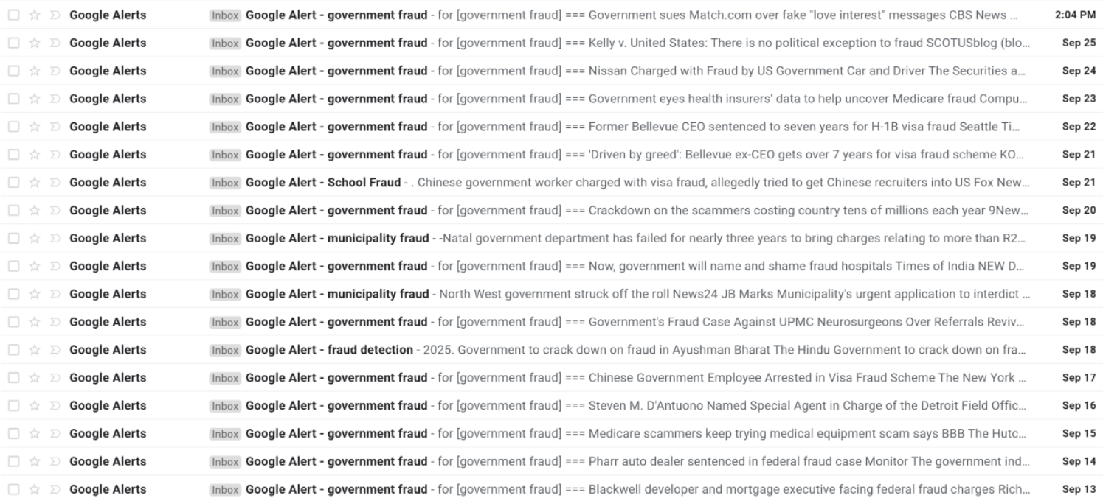
It Happens…
Notes:
Clint’s Slide
As it does happen, we monitor activity in this space on a daily basis. This is just screenshot we took of the number of events over a short period of time and there was some form of fraudulent government activity taking place almost every day.
We are searching for government and municipality fraud examples here. This particular screenshot was taken on March 27th.
Our staff looks at these cases very closely and looks to identify patterns of activity that are taking place and identify the new techniques that the perpetrators are trying to pull off and we build the recognition of those patterns into our system.

Slide 16
The Law and Your Responsibility
Under Ohio law₁:
Any public official who either authorizes an illegal expenditure of public funds or supervises the accounts of a public office from which such illegal expenditure is strictly liable for the amount of the expenditure.
Public officials controlling public funds or property are liable for the loss incurred should such funds or property be fraudulently obtained by another, converted, misappropriated, lost or stolen.
_{1.} Seward v. National Surety Corp. (1929), 120 Ohio St. 47; 1980 Op. Att’y Gen. No. 80-074; Ohio Rev. Code Section 9.39; State, ex. Rel. Village of Linndale v. Masten (1985), 18 Ohio St.3d 228.
Notes:
Tom’s Slide
Under Ohio law ……. (just read this first sentence)
This is exactly what happened in the case we just reviewed.
The things that they found that he should have been overseeing wasn’t.
He actually is responsible for and will have to pay these fines and make restitution.
You might think, well, I’m bonded. I have a bond so I should be fine. This employee, of course, is actually required to be bonded.
This problem is the bond is not there to protect you, the employee or Treasurer/CFO. The bond is there to protect the City.
So the bond might pay the City but the bond company is going to come collect $ from the Treasurer because they are the one responsible for making sure this doesn’t happen.
In this case, he is lucky it was only $95k. They could have held him liable for more.
What is happening now is Dave Yost is making a run for whatever office he is planning on pursuing so he is making noise and is cracking down. He wants to make an example out of anyone he can.
Some people here this and get frustrated that the auditors didn’t catch it. Aren’t they responsible and the answer is NO. It’s not their job.
In this case, the Treasurer was a victim too. But he has to prevent this from happening to himself. You have to protect yourself. And that is what Bonefish is here to help with.

Slide 17
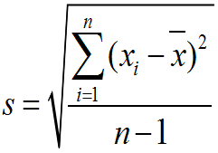
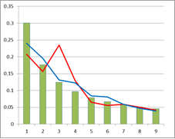
Algorithms that identify anomalies
Sophisticated technology to provide visibility to your staff
New Payroll Variance Formulas
Benford’s Law – It works
Notes:
Visually, the system is super simple to use (on purpose) and we try to limit the number of screens and clicks you need to go through to do all the things you need to do.
Behind the scenes there is a lot of super sophisticated stuff going on.
You probably have no idea what this formula means nor should you.
This is what is happening behind the scenes to help us identify unusual circumstances and look for you things you need to know and be aware of about your vendors and employees and to help you do the things you are required to do.
Benefits
You become more knowledgeable about things that are happening inside your organization.
You gain transparency
Your controls become significantly more advanced.

Slide 18
Continuous Monitoring

Slide 19
Compliance in the Government Sector?

Slide 20
The Law and Your Responsibility
Under State and Federal law:
Vendors
Employees
Federal Excluded Parties List System/ SAM.gov
EO 12549 & 12689
FR66533
New Hire Reporting Law
Ohio Revised Statute 3121.89-3121.891
Background Checks
Establish and Maintain Correct
Tax District
Ohio Findings for Recovery
ORC 9.24
Ohio Business Filings
ORC 1703.04
Debarred Contractors
ORC 4115.133
ORC 153.02
Notes:
You have a long and challenge list of requirements.
You have to check the Federal Excluded Parties List System. This system is intended to prevent funds from going to suspected terrorist groups.
You have to validate the Auditor of State Outstanding Findings for Recovery. This “Bad Guy” list is companies and individuals who have not fulfilled their contractual obligations with some state government agency and now owes them money. Until this money is paid, you are not authorized to do business with them.
The Ohio Business Filings database is a list of all businesses registered to do business in the state of Ohio. This is a very importand validation
Here are some of the laws that you are held accountable to
There is the Federal Excluded Parties List System or SAM.gov– these are the federal regulations that specify the details of what it is you are responsible for.
Most people haven’t read these, but we have. And we factor them into our programs.
There is the Ohio Findings for Recovery requirements and the section of the ORC that provide those guidelines and rules
There is the New Hire Reporting Law and the section of the Ohio Revised Statue that governs that law.
We also notify you when you have to do or re-do background checks
And we help you establish and maintain your correct tax district files

Slide 21
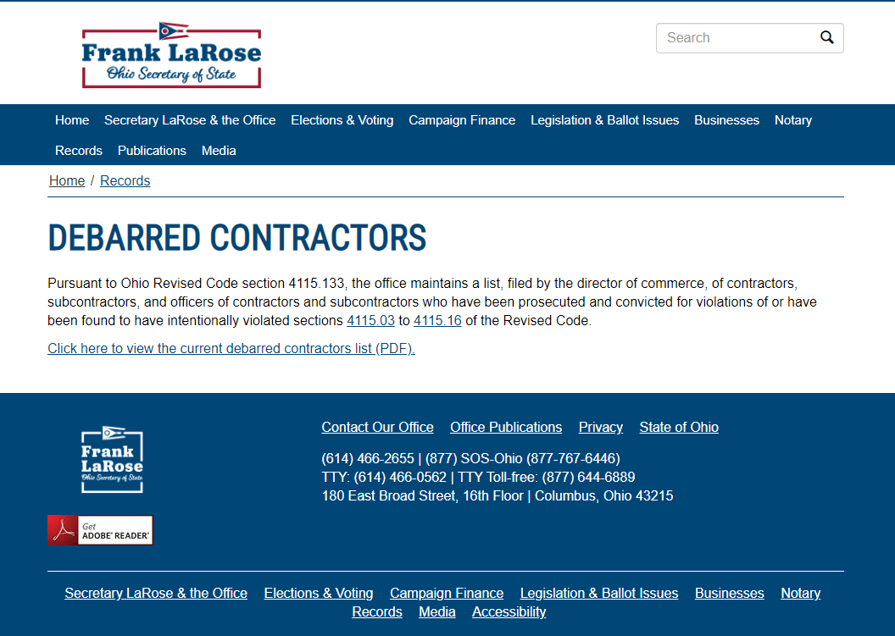
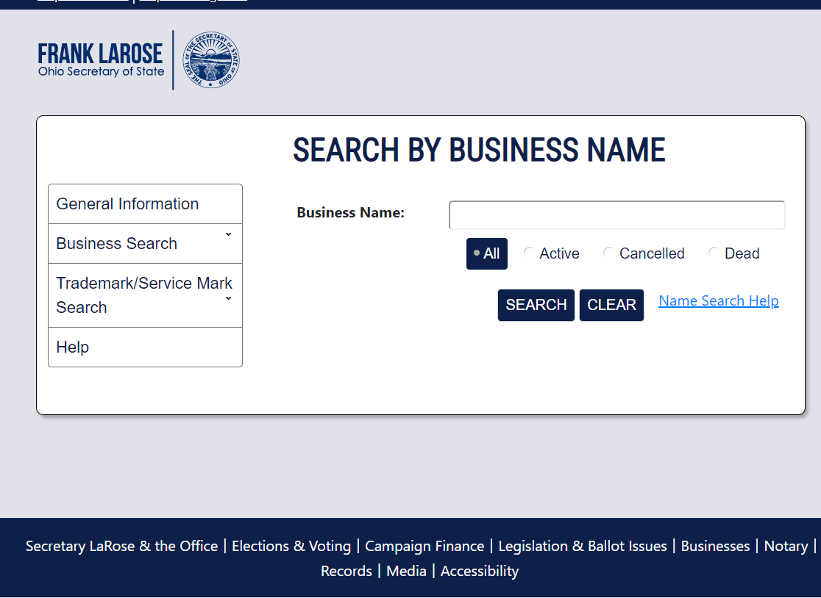
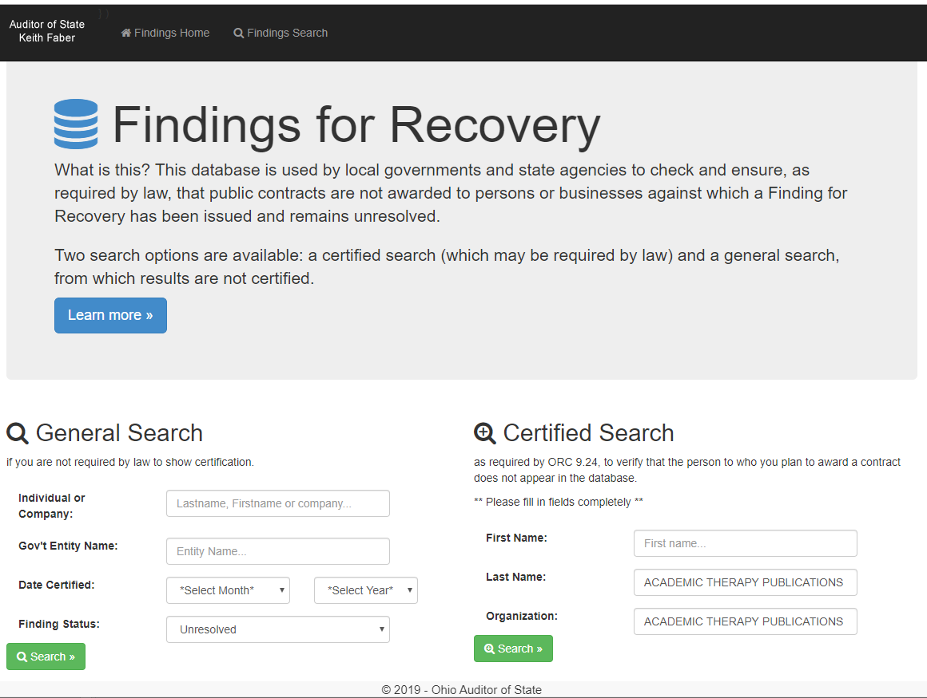
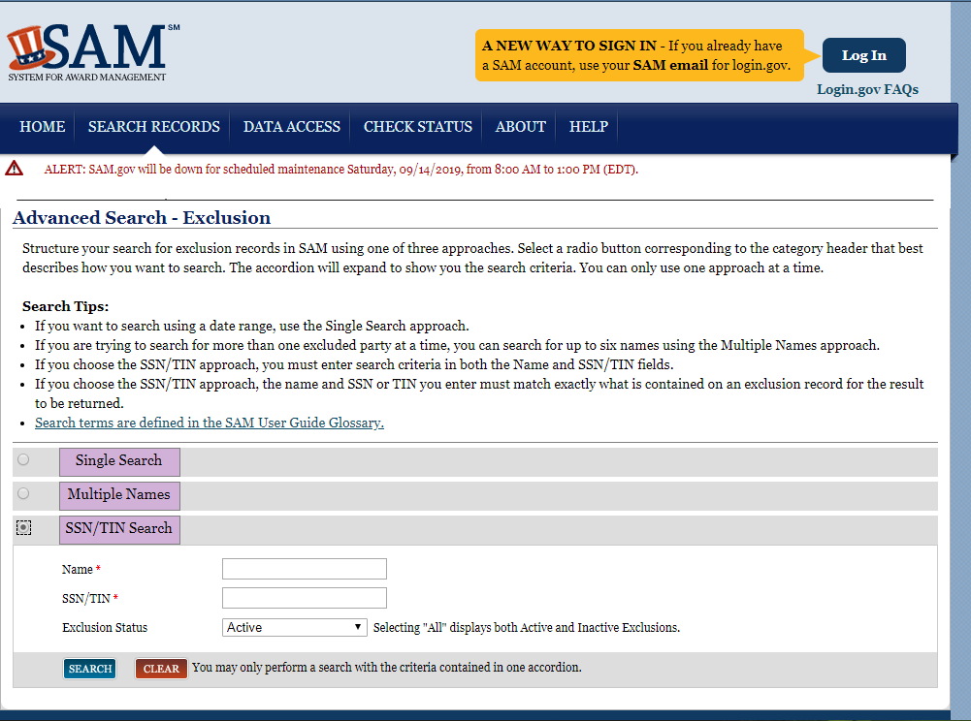
VENDOR COMPLIANCE
- HOW!?!?!
http://ffr.ohioauditor.gov/Results/Certified
https://businesssearch.sos.state.oh.us
https://www.sos.state.oh.us/records/debarred-contractors/
https://www.sam.gov/SAM/pages/public/searchRecords/advancedPIRSearch.jsf

Slide 22
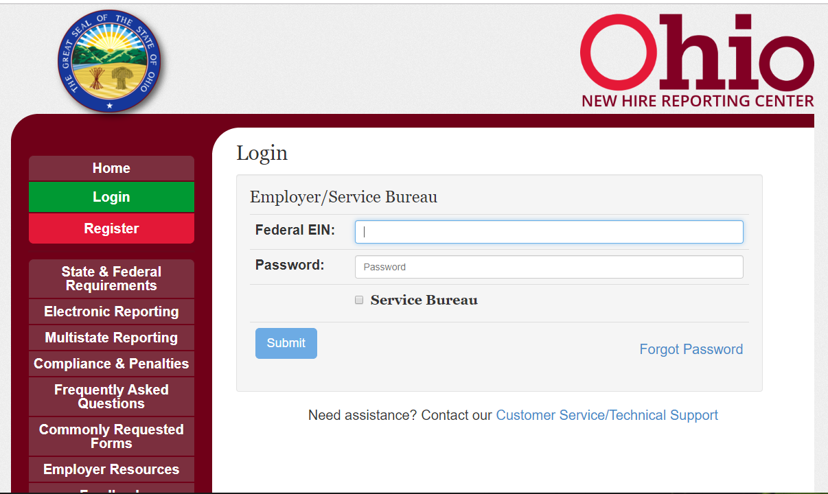
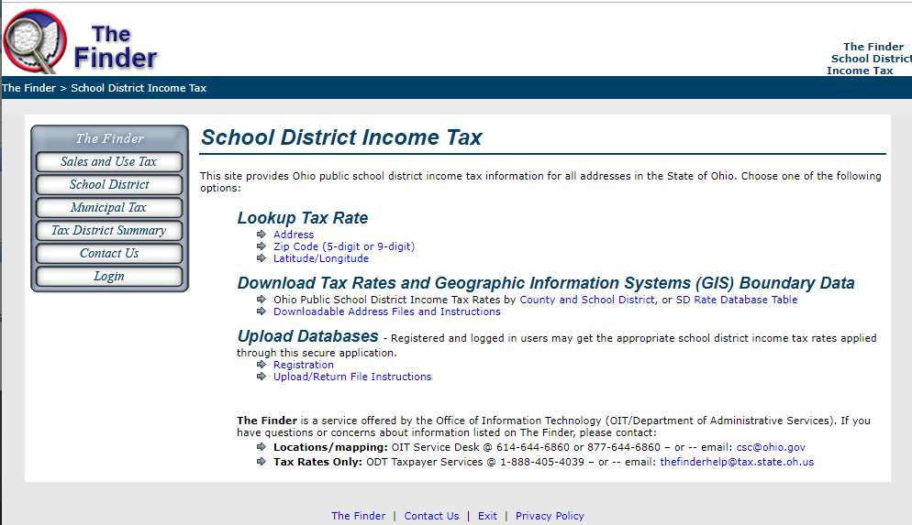
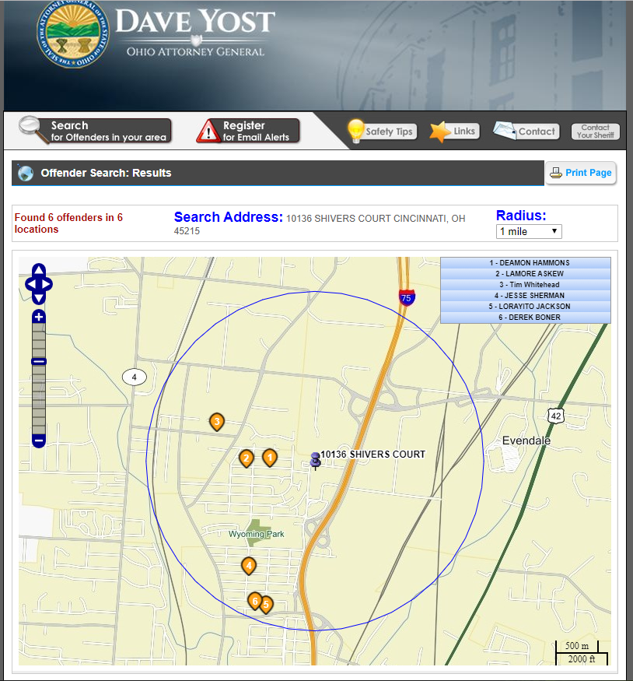
EMPLOYEE COMPLIANCE-HOW!?!
https://thefinder.tax.ohio.gov/streamlinesalestaxweb/default_schooldistrict.aspx
https://www.sam.gov/SAM/pages/public/searchRecords/advancedPIRSearch.jsf
https://newhire-reporting.com/OH-Newhire/logon.aspx
http://ffr.ohioauditor.gov/Results/Certified
http://www.icrimewatch.net/results.php?

Slide 23
Identify
COMPLIANCE TODAY
Lookup
Going out to each state and federal database is time consuming. Use automation to speed this process up!
Validate
Print
File

Slide 24
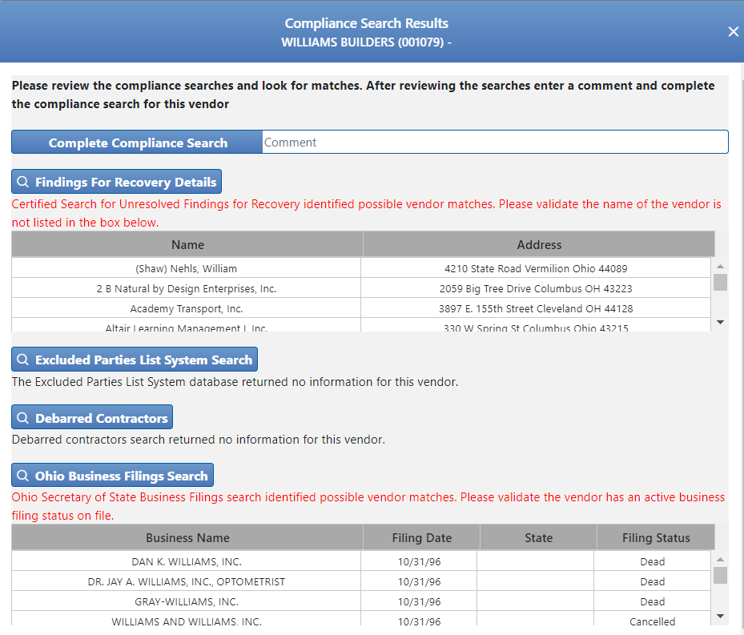
AUTOMATED COMPLIANCE
With a click of a button, see all state and federal database results and validate compliance!

Slide 25
ADVANTAGES TO AUTOMATED COMPLIANCE
While providing controls and automation, time saving more than offsets time spent implementing controls.
Ensures all External Searches are identified
Time savings during audit
Paperless, easy-to-find
eVAS outstanding External Search Report
eVAS External Search Audit Report

Slide 26
Conclusion
New fraud schemes arise everyday
New and increased compliance requirements are imposed every year
Fiscal office staffing remains constant at best
Automation no longer a luxury but a necessity

Slide 27
Questions?

Slide 28
Contact Information
info@bonefishsystems.com
614-427-3824
Notes:
Clint’s Slide
Point Brandon out again
Tell everyone about the next Lunch & Learn coming up in August
Mention folders and other materials Brandon has available for anyone wanting more information

